Slide 1
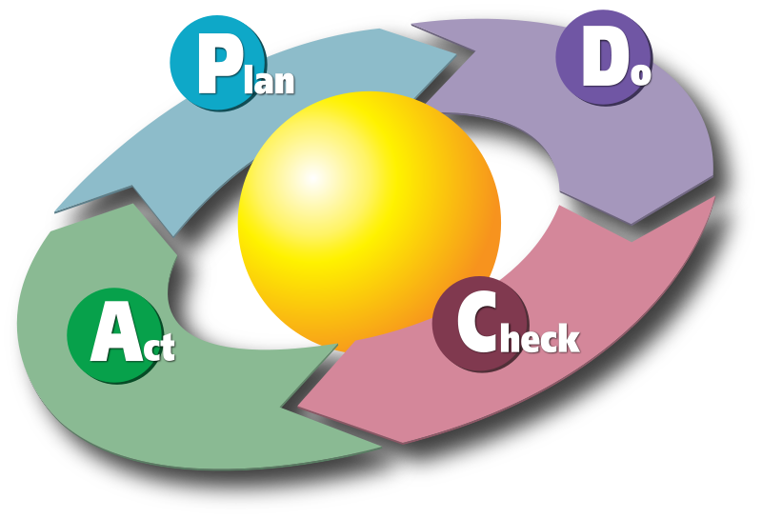
Test Driven Development:
C#

Slide 2
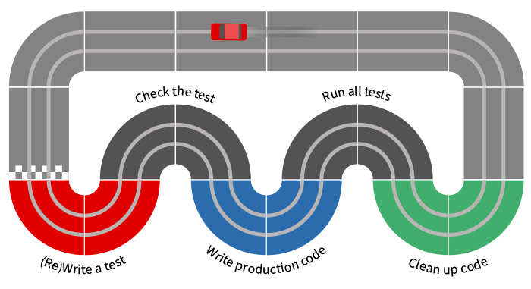
TDD

Slide 3
TDD Goals
What Is Test-driven Development
How Do I Adopt TDD?
Testing Concepts
Test-driven Development Concepts
Testing Tools
Setting Up Testing Infrastructure
Installing Java SDK and Eclipse IDE
Unit Testing Java code with jUnit

Slide 4
TDD Goals
JUnit in Action
Testing for Exceptions
@Before and @After
Decoupling
Mock Objects
Mockito in Action
Add the Mockito Dependency
Stubbing and Setting Expectations
Verify the results

Slide 5
TDD Goals
Test a negative scenario
Mocking Exceptions
Verification Mode
Add the Mockito Dependency
Stub Void Methods Implicitly
Stub Void Methods Explicitly
say doNothing to test Consecutive calls
The F.I.R.S.T Principle
Test Doubles Introduction
Test Doubles In Mockito
Refactoring

Slide 6
TDD Goals
Web Tier Testing
Middle Tier Testing
Testing Legacy Code
Continuous Integration Testing

Slide 7
What is TDD
Test-Driven Development (TDD) is a technique for building software that guides software development by writing tests. (Martin Fowler’s definition)
“Test Driven Development” is NOT primarily about testing or development (i.e., coding)
It is rather about design - where design is evolved through refactoring
Developers write unit tests (NOT testers) and then code

Slide 8
What is TDD
The primary goal of TDD is to make the code clearer, simple and bug-free.
Test-Driven Development starts with designing and developing tests for every small functionality of an application.
In TDD approach, first, the test is developed which specifies and validates what the code will do.

Slide 9
Old Approach

Slide 10
New Approach

Slide 11
TDD? But I already write unit tests!
The simple concept of TDD is to write and correct the failed tests before writing new code (before development).
This helps to avoid duplication of code as we write a small amount of code at a time in order to pass tests. (Tests are nothing but requirement conditions that we need to test to fulfill them).
Test-Driven development is a process of developing and running automated test before actual development of the application.
Hence, TDD sometimes also called as Test First Development.

Slide 12
Why TDD
TDD as a technique for specifying your requirements and design before writing the actual program code.
The second view takes a more pragmatic approach and sees TDD as a technique that helps programmers write better code.
Regardless of the view one takes, what TDD practitioners all agree on is that TDD will not only improve your code, but it will also improve the overall design and implementation of your software system.

Slide 13
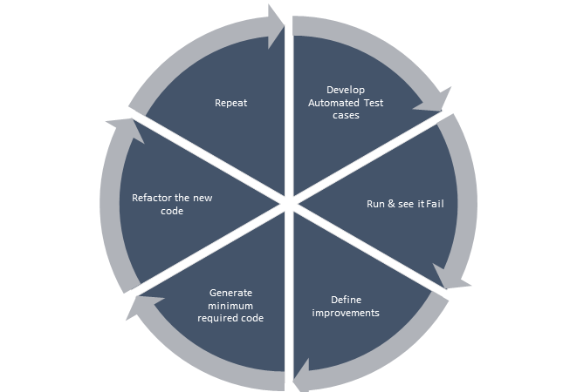
Why TDD

Slide 14
Why TDD
Reduce development costs
Cut down time to market in the development process
Improve programmer’s productivity
Develop a neat code that is well-defined
Cut down turnaround time
Generates proof that the developed code works as expected
Boosts the process of generating quality code

Slide 15
Why TDD
A significant advantage of TDD is that it enables you to take small steps when writing software.
This is a practice that I have promoted for years because it is far more productive than attempting to code in large steps.
For example, assume you add some new functional code, compile, and test it.
Chances are pretty good that your tests will be broken by defects that exist in the new code.
It is much easier to find, and then fix, those defects if you've written two new lines of code than two thousand.
The implication is that the faster your compiler and regression test suite, the more attractive it is to proceed in smaller and smaller steps.
I generally prefer to add a few new lines of functional code, typically less than ten, before I recompile and rerun my tests.

Slide 16
TDD mantra

Slide 17
TDD mantra
Red—write a little test that doesn’t work, perhaps doesn’t even compile at first
Green—make the test work quickly, committing whatever sins necessary in the process
Refactor—eliminate all the duplication and smells created in just getting the test to work

Slide 18
3 laws of TDD
Law 1: You may not write production code unless you’ve first written a failing unit test.
Law 2: You may not write more of a unit test than is sufficient to fail.
Law 3: You may not write more production code than is sufficient to make the failing unit test pass.

Slide 19
TDD Benefits
Early bug notification
Developers test their code but in the database world, this often consists of manual tests or one-off scripts.
Using TDD you build up, over time, a suite of automated tests that you and any other developer can rerun at will.
Better Designed, cleaner and more extensible code.
It helps to understand how the code will be used and how it interacts with other modules.
It results in better design decision and more maintainable code.
TDD allows writing smaller code having single responsibility rather than monolithic procedures with multiple responsibilities. This makes the code simpler to understand.
TDD also forces to write only production code to pass tests based on user requirements.

Slide 20
TDD Benefits
Confidence to Refactor
If you refactor code, there can be possibilities of breaks in the code. So having a set of automated tests you can fix those breaks before release. Proper warning will be given if breaks found when automated tests are used.
Using TDD, should results in faster, more extensible code with fewer bugs that can be updated with minimal risks.
Good for teamworkIn the absence of any team member, other team members can easily pick up and work on the code. It also aids knowledge sharing, thereby making the team more effective overall.
Good for DevelopersThough developers have to spend more time in writing TDD test cases, it takes a lot less time for debugging and developing new features. You will write cleaner, less complicated code.

Slide 21
TDD Benefits

Slide 22
Impact of Adopting TDD
Using TDD to produce code means that developers begin by setting out exactly what the code should do rather than beginning with how the code should satisfy the requirement.
The advantage of this is that the developer is focused on what the code needs to achieve from the outset rather than writing code in a more generalised way.
At Boost found that continuous testing quite naturally results in fewer defects and TTD results in a greater understanding of what the code should achieve as well as cleaner code.

Slide 23
How Do I Adopt TDD
Add a test.
Run all tests and see if any new test fails.
Write some code.
Run tests and Refactor code.
Repeat.

Slide 24
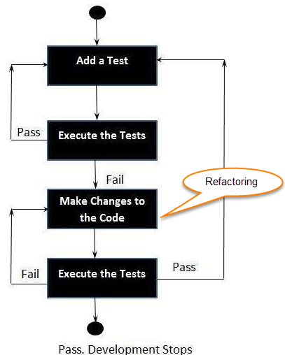
How Do I Adopt TDD

Slide 25
Extreme Programming Practise

Slide 26
What is acceptance TDD and Developer TDD
Acceptance TDD (ATDD):
With ATDD you write a single acceptance test.
This test fulfills the requirement of the specification or satisfies the behavior of the system.
After that write just enough production/functionality code to fulfill that acceptance test.
Acceptance test focuses on the overall behavior of the system.
ATDD also was known as Behavioral Driven Development (BDD).

Slide 27
What is acceptance TDD and Developer TDD
Developer TDD
With Developer TDD you write single developer test i.e. unit test and then just enough production code to fulfill that test.
The unit test focuses on every small functionality of the system.
Developer TDD is simply called as TDD.
The main goal of ATDD and TDD is to specify detailed, executable requirements for your solution on a just in time (JIT) basis.
JIT means taking only those requirements in consideration that are needed in the system. So increase efficiency.

Slide 28
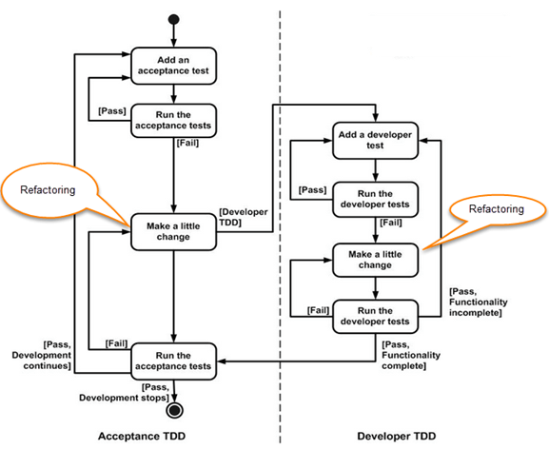
What is acceptance TDD and Developer TDD

Slide 29
Scaling TDD via Agile Model Driven Development (AMDD)
TDD is very good at detailed specification and validation.
It fails at thinking through bigger issues such as overall design, use of the system, or UI.
AMDD addresses the Agile scaling issues that TDD does not.
Thus AMDD used for bigger issues.

Slide 30
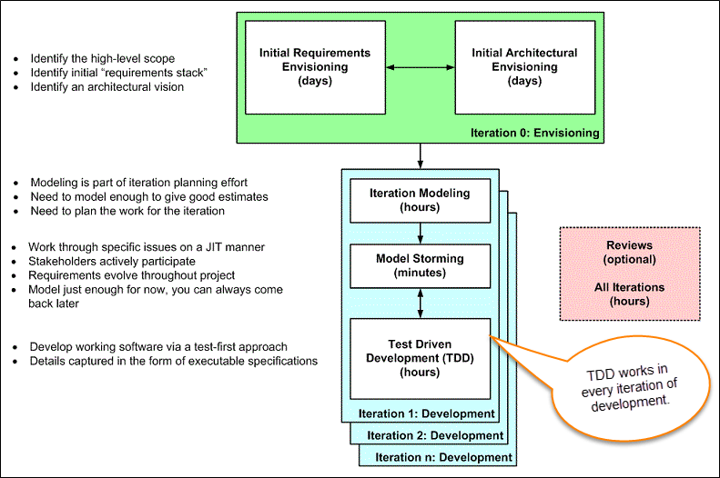
Scaling TDD via Agile Model Driven Development (AMDD)

Slide 31
Scaling TDD via Agile Model Driven Development (AMDD)
Iteration 0: Envisioning
There are two main sub-activates.
Initial requirements envisioning.It may take several days to identify high-level requirements and scope of the system. The main focus is to explore usage model, Initial domain model, and user interface model (UI).
Initial Architectural envisioning.It also takes several days to identify architecture of the system. It allows setting technical directions for the project. The main focus is to explore technology diagrams, User Interface (UI) flow, domain models, and Change cases.

Slide 32
Scaling TDD via Agile Model Driven Development (AMDD)
Iteration modeling:Here team must plan the work that will be done for each iteration.
Agile process is used for each iteration, i.e. during each iteration, new work item will be added with priority.
First higher prioritized work will be taken into consideration. Work items added may be reprioritized or removed from items stack any time.
The team discusses how they are going to implement each requirement. Modeling is used for this purpose.
Modeling analysis and design is done for each requirement which is going to implement for that iteration.

Slide 33
Scaling TDD via Agile Model Driven Development (AMDD)
Model storming:
This is also known as Just in time Modeling.
Here modeling session involves a team of 2/3 members who discuss issues on paper or whiteboard.
One team member will ask another to model with them. This modeling session will take approximately 5 to 10 minutes. Where team members gather together to share whiteboard/paper.
They explore issues until they don't find the main cause of the problem. Just in time, if one team member identifies the issue which he/she wants to resolve then he/she will take quick help of other team members.
Other group members then explore the issue and then everyone continues on as before. It is also called as stand-up modeling or customer QA sessions.

Slide 34
Scaling TDD via Agile Model Driven Development (AMDD)
Test Driven Development (TDD).
It promotes confirmatory testing of your application code and detailed specification.
Both acceptance test (detailed requirements) and developer tests (unit test) are inputs for TDD.
TDD makes the code simpler and clear. It allows the developer to maintain less documentation.

Slide 35
Scaling TDD via Agile Model Driven Development (AMDD)
Reviews.
This is optional. It includes code inspections and model reviews.
This can be done for each iteration or for the whole project.
This is a good option to give feedback for the project.

Slide 36
TDD vs AMDD
TDD | AMDD
TDD shortens the programming feedback loop | AMDD shortens modeling feedback loop.
TDD is detailed specification | AMDD works for bigger issues
TDD promotes the development of high-quality code | AMDD promotes high-quality communication with stakeholders and developers.
TDD speaks to programmers | AMDD talks to business analyst, stakeholders, and data professionals.
TDD non-visually oriented | AMDD visually oriented
TDD has limited scope to software works | AMDD has a broad scope including stakeholders. It involves working towards a common understanding
Both support evolutionary development | --------------------------------------------

Slide 37
How Do I Adopt TDD

Slide 38
Adoption Stages
The developer also notices that when they return to some code that they haven't seen for a while, the tests serve to document how the code works.
A point of revelation occurs when the developer realizes that writing tests in this way helps them to "discover" the API to their code. TDD has now become a design process.
Expertise in TDD begins to be drawn at the point where the developer realizes that TDD is not about testing, it is about defining behavior.
Behavior is about the interactions between components of the system and so the use of mocking is a fundamental to advanced TDD.

Slide 39
Adoption Stages
1. The developer starts writing unit tests around their code using a test framework like JUnit or TestNG.
2. As the body of tests increases the developer begins to enjoy a strongly increased sense of confidence in their work.
3. At some point the developer has the insight (or are shown) that writing the tests before writing the code, helps them focus on only writing the code that they need.

Slide 40
Measuring and Monitoring Adoption
Time of running and manually testing your application - measure the time it takes to run your application and test it manually. With TDD it will decrease.
Object-oriented design quality
Cohesion (increase)
Method’s length (decrease)
Cyclomatic complexity (decrease)
install Sonar or another tool for static code analysis. Observe key design metrics.

Slide 41
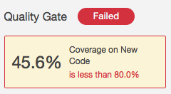
Measuring and Monitoring Adoption
Code coverage
This metric defines the percentage of your production code that is exercised (run) by the tests. With TDD you can expect it to increase, of course.
monitor Code Coverage for new code. Expect it to rise after adopting TDD.

Slide 42
Measuring and Monitoring Adoption
Bug fixing time
Automated developer tests will catch whole classes of defects.
You’ll stop wasting time on simple calculation mistakes, rounding errors or simple regression bugs.
For the whole team, expect a significant reduction of the time spent identifying, tracking and fixing bugs.
monitor the time your team reports on identifying, managing and fixing defects. Expect it to reduce after adopting TDD.

Slide 43
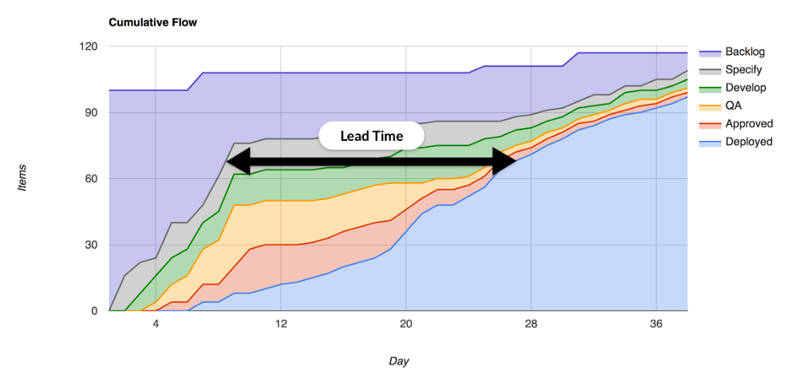
Measuring and Monitoring Adoption
Average Lead Time
Lead Time is the time elapsed between starting work on a certain feature and delivering it to production environment.
You can monitor Lead Times for each particular feature or just take the average.

Slide 44
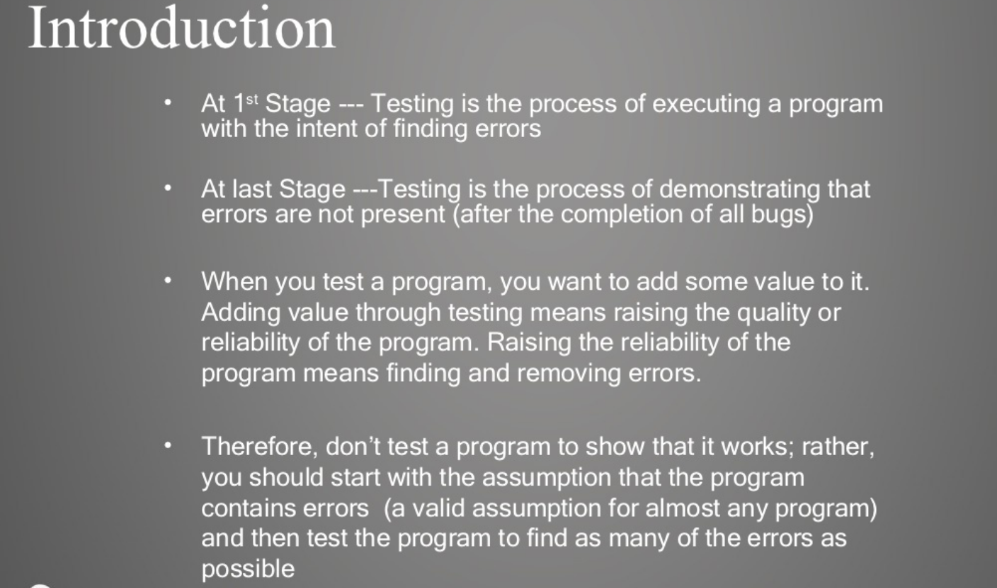
Testing Concepts

Slide 45
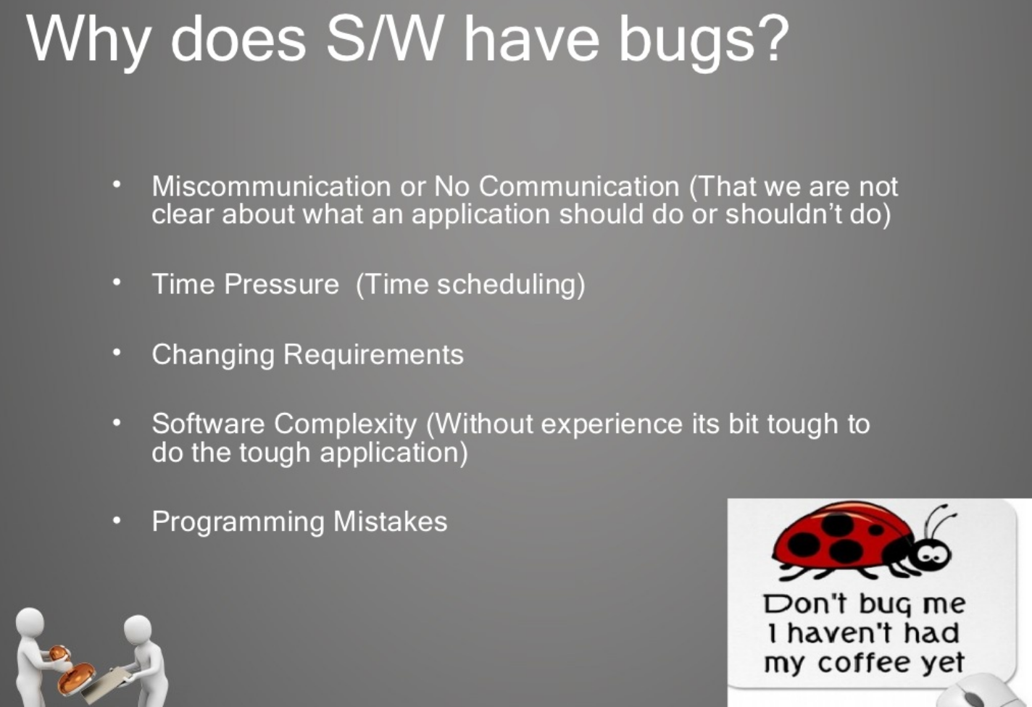
Testing Concepts

Slide 46
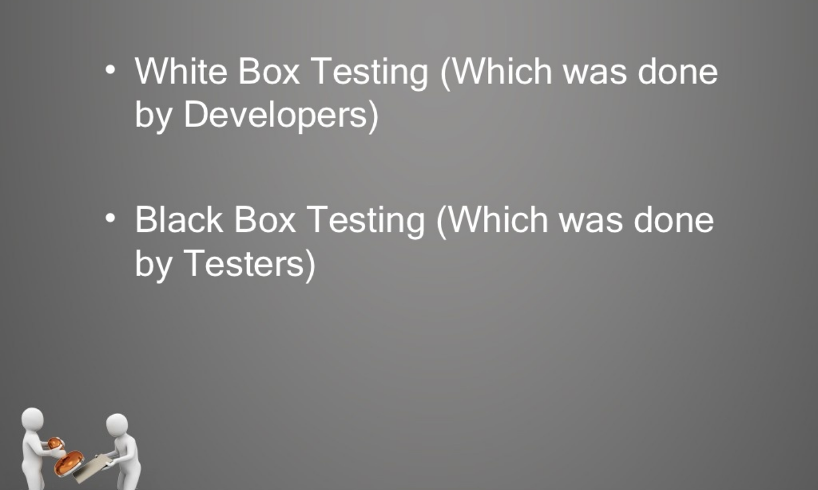
Testing Concepts
Testing Techniques

Slide 47
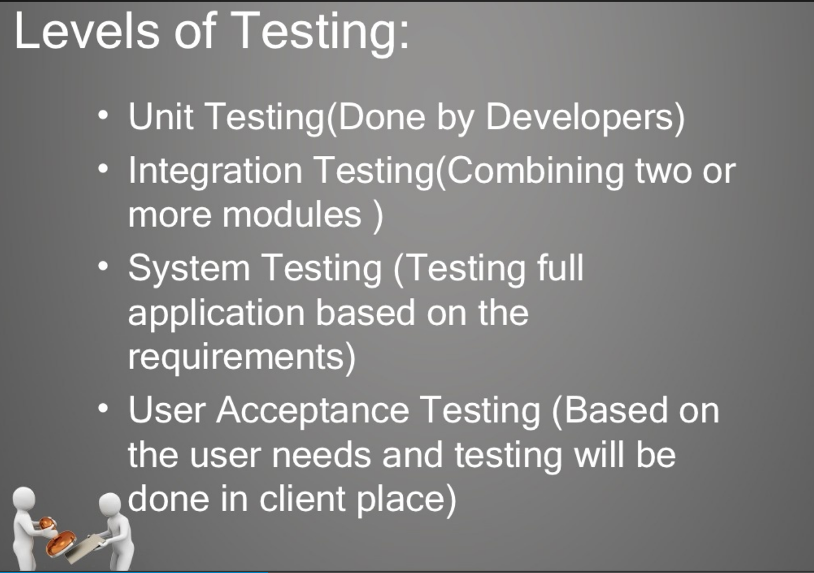
Testing Concepts

Slide 48
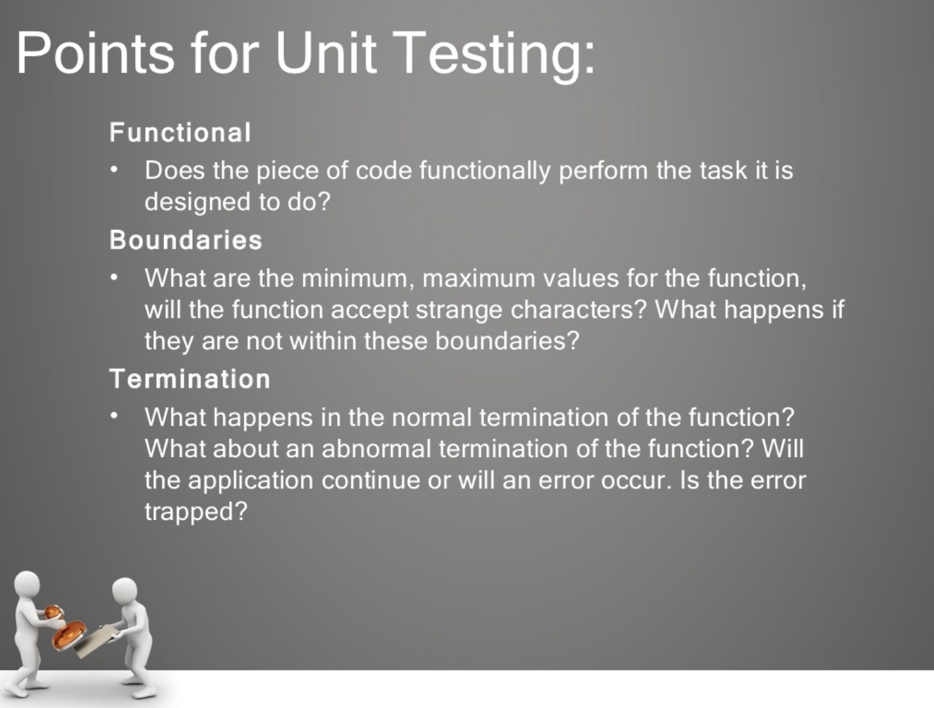
Testing Concepts

Slide 49
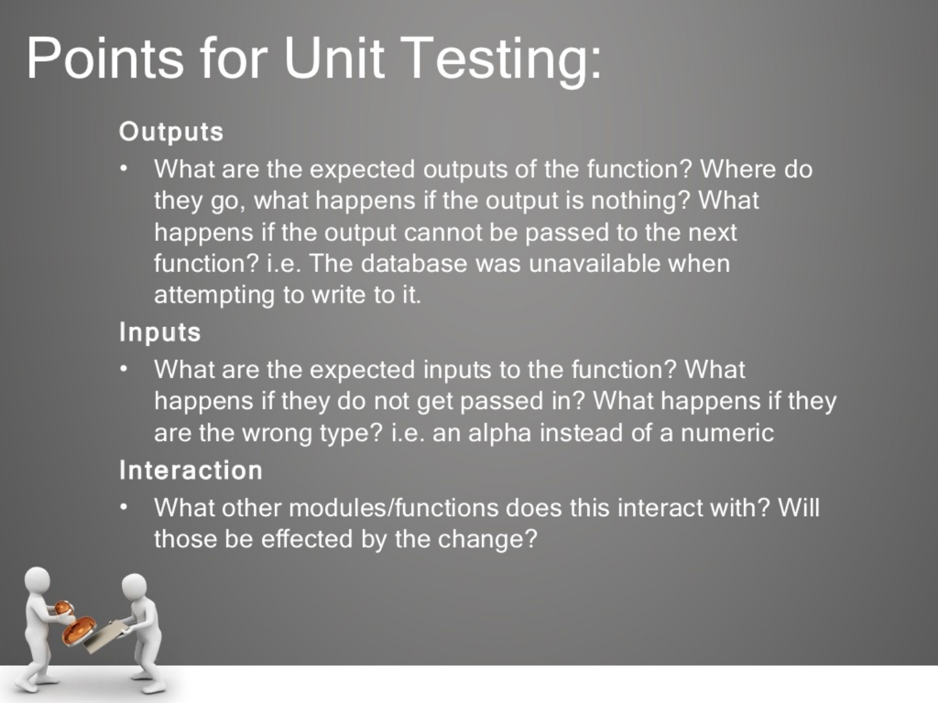
Testing Concepts

Slide 50
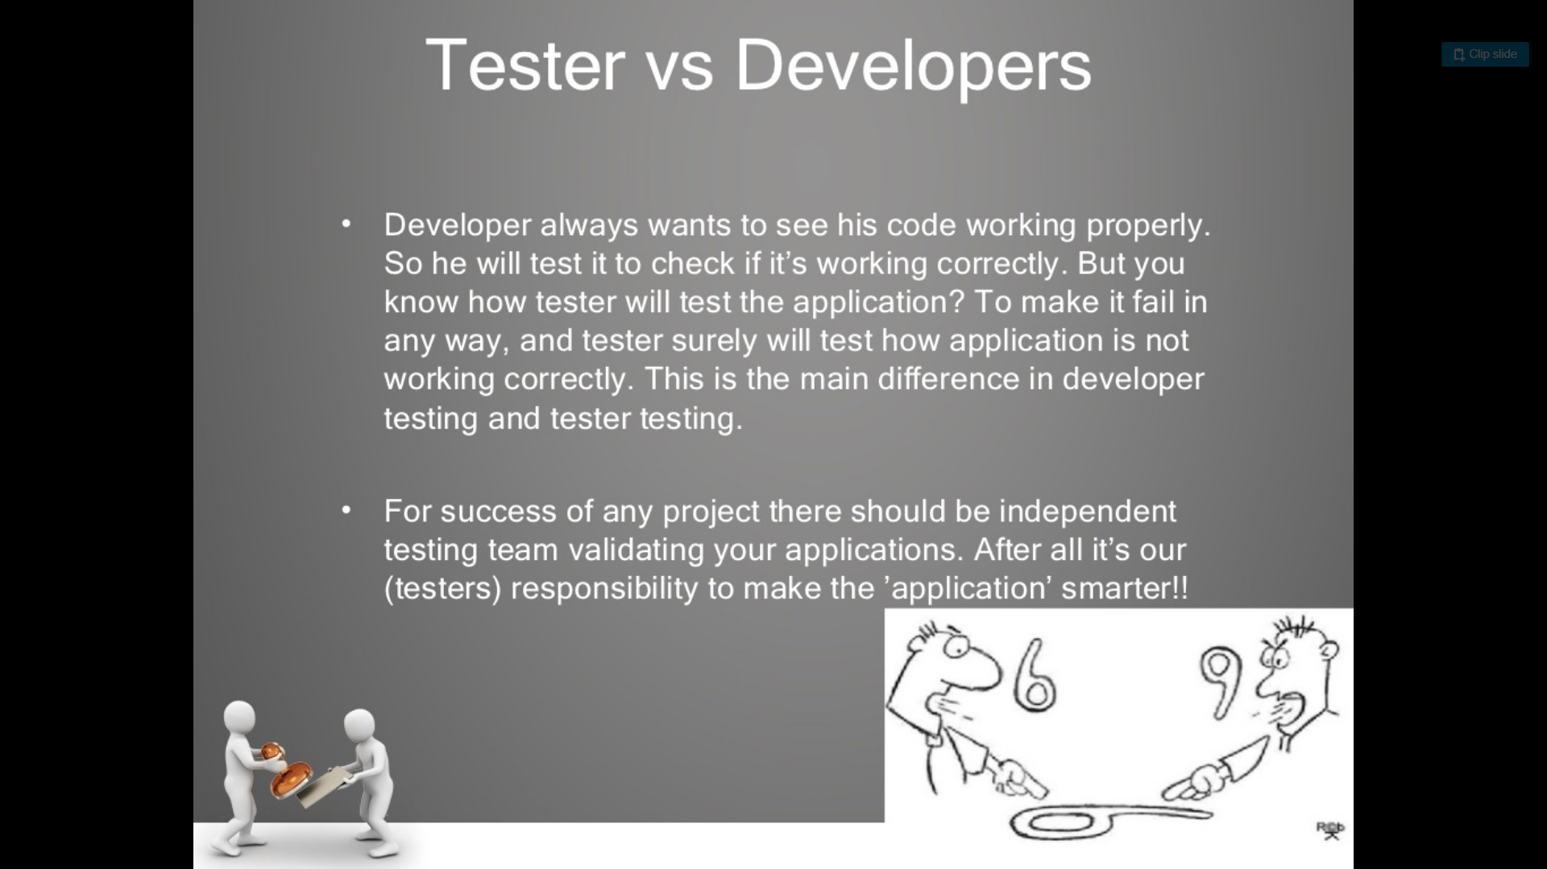
Testing Concepts

Slide 51
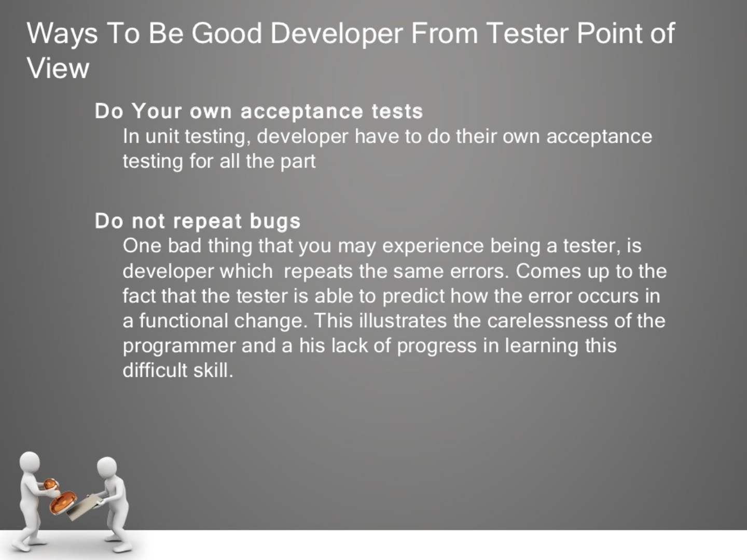
Testing Concepts

Slide 52
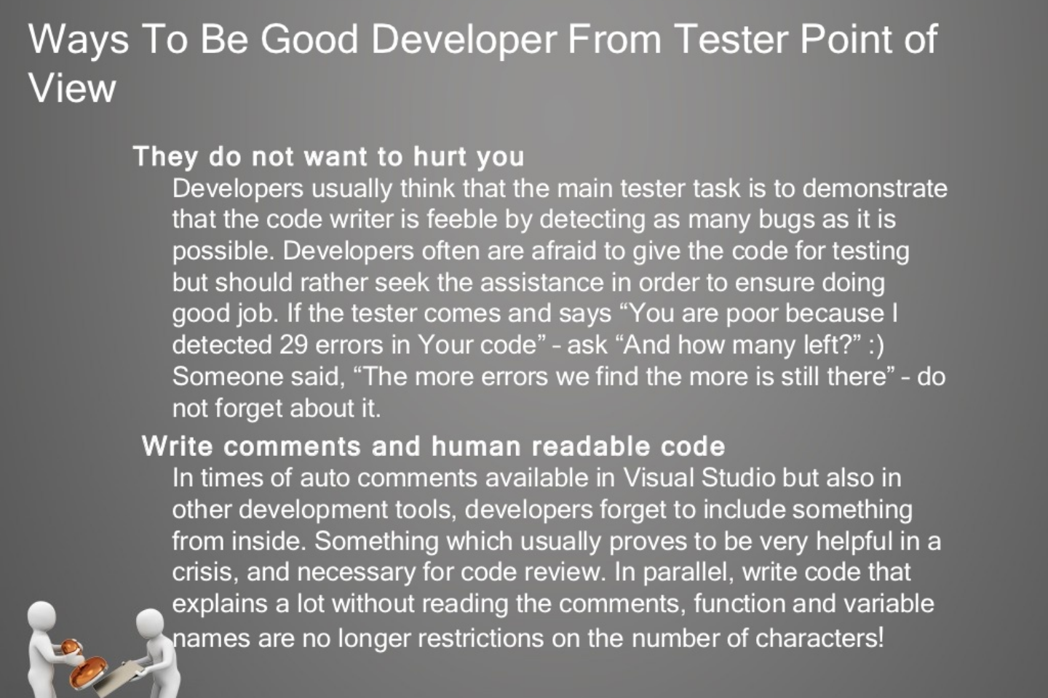
Testing Concepts

Slide 53
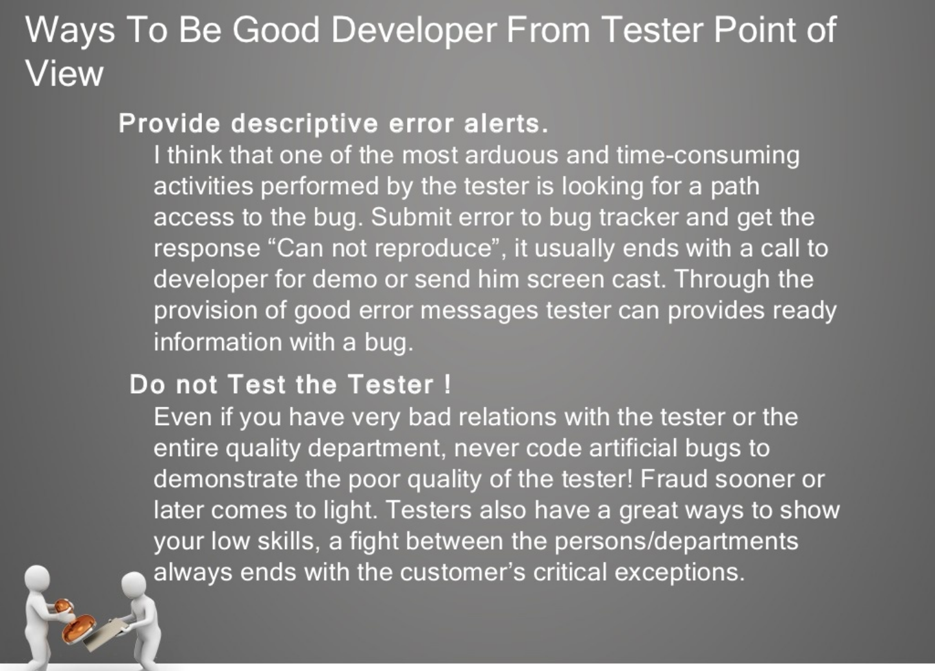
Testing Concepts

Slide 54
Good Testing Practices
A good test case is one that has a high probability of detecting an undiscovered defect, not one that shows that the program works correctly
It is impossible to test your own program
A necessary part of every test case is a description of the expected result

Slide 55
Good Testing Practices (cont’d)
Avoid non reproducible or on-the-fly testing
Write test cases for valid as well as invalid input conditions.
Thoroughly inspect the results of each test
As the number of detected defects in a piece of software increases, the probability of the existence of more undetected defects also increases

Slide 56
Good Testing Practices (cont’d)
Assign your best people to testing
Ensure that testability is a key objective in your software design
Never alter the program to make testing easier
Testing, like almost every other activity, must start with objectives

Slide 57
Levels of Testing
Unit Testing
Integration Testing
Validation Testing
Regression Testing
Alpha Testing
Beta Testing
Acceptance Testing

Slide 58
Unit Testing
Algorithms and logic
Data structures (global and local)
Interfaces
Independent paths
Boundary conditions
Error handling

Slide 59
Why Integration Testing Is Necessary
One module can have an adverse effect on another
Sub functions, when combined, may not produce the desired major function
Individually acceptable imprecision in calculations may be magnified to unacceptable levels

Slide 60
Why Integration Testing Is Necessary (cont’d)
Interfacing errors not detected in unit testing may appear
Timing problems (in real-time systems) are not detectable by unit testing
Resource contention problems are not detectable by unit testing

Slide 61
Top-Down Integration
The main control module is used as a driver, and stubs are substituted for all modules directly subordinate to the main module.
Depending on the integration approach selected (depth or breadth first), subordinate stubs are replaced by modules one at a time.

Slide 62
Top-Down Integration (cont’d)
Tests are run as each individual module is integrated.
On the successful completion of a set of tests, another stub is replaced with a real module
Regression testing is performed to ensure that errors have not developed as result of integrating new modules

Slide 63
Problems with Top-Down Integration
Many times, calculations are performed in the modules at the bottom of the hierarchy
Stubs typically do not pass data up to the higher modules
Delaying testing until lower-level modules are ready usually results in integrating many modules at the same time rather than one at a time
Developing stubs that can pass data up is almost as much work as developing the actual module

Slide 64
Bottom-Up Integration
Integration begins with the lowest-level modules, which are combined into clusters, or builds, that perform a specific software sub function
Drivers (control programs developed as stubs) are written to coordinate test case input and output
The cluster is tested
Drivers are removed and clusters are combined moving upward in the program structure

Slide 65
Problems with Bottom-Up Integration
The whole program does not exist until the last module is integrated
Timing and resource contention problems are not found until late in the process

Slide 66
Validation Testing
Determine if the software meets all of the requirements defined in the SRS
Having written requirements is essential
Regression testing is performed to determine if the software still meets all of its requirements in light of changes and modifications to the software
Regression testing involves selectively repeating existing validation tests, not developing new tests

Slide 67
Alpha and Beta Testing
It’s best to provide customers with an outline of the things that you would like them to focus on and specific test scenarios for them to execute.
Provide with customers who are actively involved with a commitment to fix defects that they discover.

Slide 68
Acceptance Testing
Similar to validation testing except that customers are present or directly involved.
Usually the tests are developed by the customer

Slide 69
Test Methods
White box or glass box testing
Black box testing
Top-down and bottom-up for performing incremental integration
ALAC (Act-like-a-customer)

Slide 70
Test Types
Functional tests
Algorithmic tests
Positive tests
Negative tests
Usability tests
Boundary tests
Startup/shutdown tests
Platform tests
Load/stress tests

Slide 71
Concurrent Development/ Validation Testing Model
Conduct informal validation while development is still going on
Provides an opportunity for validation tests to be developed and debugged early in the software development process
Provides early feedback to software engineers
Results in formal validation being less eventful, since most of the problems have already been found and fixed

Slide 72
Validation Readiness Review
During informal validation developers can make any changes needed in order to comply with the SRS.
During informal validation QA runs tests and makes changes as necessary in order for tests to comply with the SRS.

Slide 73
Validation Readiness Review (cont’d)
During formal validation the only changes that can be made are bug fixes in response to bugs reported during formal validation testing. No new features can be added at this time.
During formal validation the same set of tests run during informal validation is run again. No new tests are added.

Slide 74
Entrance Criteria for Formal Validation Testing
Software development is completed (a precise definition of “completed” is required.
The test plan has been reviewed, approved and is under document control.
A requirements inspection has been performed on the SRS.
Design inspections have been performed on the SDDs (Software Design Descriptions).

Slide 75
Entrance Criteria for Formal Validation Testing (cont’d)
Code inspections have been performed on all “critical modules”.
All test scripts are completed and the software validation test procedure document has been reviewed, approved, and placed under document control.
Selected test scripts have been reviewed, approved and placed under document control.

Slide 76
Entrance Criteria for Formal Validation Testing (cont’d)
All test scripts have been executed at least once.
CM tools are in place and all source code is under configuration control.
Software problem reporting procedures are in place.
Validation testing completion criteria have been developed, reviewed, and approved.

Slide 77
Formal Validation
The same tests that were run during informal validation are executed again and the results recorded.
Software Problem Reports (SPRs) are submitted for each test that fails.
SPR tracking is performed and includes the status of all SPRs ( i.e., open, fixed, verified, deferred, not a bug)

Slide 78
Formal Validation (cont’d)
For each bug fixed, the SPR identifies the modules that were changed to fix the bug.
Baseline change assessment is used to ensure only modules that should have changed have changed and no new features have slipped in.
Informal code reviews are selectively conducted on changed modules to ensure that new bugs are not being introduced.

Slide 79
Formal Validation (cont’d)
Time required to find and fix bugs (find-fix cycle time) is tracked.
Regression testing is performed using the following guidelines:
Use complexity measures to help determine which modules may need additional testing
Use judgment to decide which tests to be rerun
Base decision on knowledge of software design and past history

Slide 80
Formal Validation (cont’d)
Track test status (i.e., passed, failed, or not run).
Record cumulative test time (cumulative hours of actual testing) for software reliability growth tracking.

Slide 81
Exit Criteria for Validation Testing
All test scripts have been executed.
All SPRs have been satisfactorily resolved. (Resolution could include bugs being fixed, deferred to a later release, determined not to be bugs, etc.) All parties must agree to the resolution. This criterion could be further defined to state that all high-priority bugs must be fixed while lower-priority bugs can be handled on a case-by-case basis.

Slide 82
Exit Criteria for Validation Testing (cont’d)
All changes made as a result of SPRs have been tested.
All documentation associated with the software (such as SRS, SDD, test documents) have been updated to reflect changes made during validation testing.
The test report has been reviewed and approved.

Slide 83
Test Planning
The Test Plan – defines the scope of the work to be performed
The Test Procedure – a container document that holds all of the individual tests (test scripts) that are to be executed
The Test Report – documents what occurred when the test scripts were run

Slide 84
Test Plan
Questions to be answered:
How many tests are needed?
How long will it take to develop those tests?
How long will it take to execute those tests?
Topics to be addressed:
Test estimation
Test development and informal validation
Validation readiness review and formal validation
Test completion criteria

Slide 85
Test Estimation
Number of test cases required is based on:
Testing all functions and features in the SRS
Including an appropriate number of ALAC (Act Like A Customer) tests including:
Do it wrong
Use wrong or illegal combination of inputs
Don’t do enough
Do nothing
Do too much
Achieving some test coverage goal
Achieving a software reliability goal

Slide 86
Considerations in Test Estimation
Test Complexity – It is better to have many small tests that a few large ones.
Different Platforms – Does testing need to be modified for different platforms, operating systems, etc.
Automated or Manual Tests – Will automated tests be developed? Automated tests take more time to create but do not require human intervention to run.

Slide 87
Estimating Tests Required
SRS Reference | Estimated Number of Tests Required | Notes
4.1.1 | 3 | 2 positive and 1 negative test
4.1.2 | 2 | 2 automated tests
4.1.3 | 4 | 4 manual tests
4.1.4 | 5 | 1 boundary condition, 2 error conditions, 2 usability tests
…
Total | 165

Slide 88
Estimated Test Development Time
Estimated Number of Tests: 165
Average Test Development Time: 3.5
(person-hours/test)
Estimated Test Development Time: 577.5
(person-hours)

Slide 89
Estimated Test Execution Time
Estimated Number of Tests: 165
Average Test Execution Time: 1.5
(person-hours/test)
Estimated Test Execution Time: 247.5
(person-hours)
Estimated Regression Testing (50%): 123.75
(person-hours)
Total Estimated Test Execution Time: 371.25
(person-hours)

Slide 90
Test Procedure
Collection of test scripts
An integral part of each test script is the expected results
The Test Procedure document should contain an unexecuted, clean copy of every test so that the tests may be more easily reused

Slide 91
TDD Design Patterns
Pass/Fail Patterns
These patterns are your first line of defence (or attack, depending on your perspective) to guarantee good code.
But be warned, they are deceptive in what they tell you about the code.
The Simple-Test Pattern
The Code-Path Pattern
The Parameter-Range Pattern

Slide 92
TDD Design Patterns
Data Transaction Patterns
Data transaction patterns are a start at embracing the issues of data persistence and communication.
These patterns intentionally omit stress testing, for example, loading on the server
The Simple-Data-I/O Pattern
The Constraint-Data Pattern
The Rollback Pattern

Slide 93
TDD Design Patterns
Collection Management Patterns
A lot of what applications do is manage collections of information. While there are a variety of collections available to the programmer, it is important to verify that the code is using the correct collection.
This affects ordering and constraints.
The Collection-Order Pattern
The Enumeration Pattern The
Collection-Constraint Pattern
The Collection-Indexing Pattern

Slide 94
TDD Design Patterns
Performance Patterns
Unit testing should not just be concerned with function but also with form.
How efficiently does the code under test perform its function? How fast? How much memory does it use?
Does it trade off data insertion for data retrieval effectively? Does it free up resources correctly?
These are all things that are under the purview of unit testing.
By including performance patterns in the unit test, the implementer has a goal to reach, which results in better code, a better application, and a happier customer.
The Performance-Test Pattern

Slide 95
TDD Design Patterns
Process Patterns
Unit testing is intended to test, well, units...the basic functions of the application.
It can be argued that testing processes should be relegated to the acceptance test procedures, however I don't buy into this argument.
A process is just a different type of unit. Testing processes with a unit tester provide the same advantages as other unit testing--it documents the way the process is intended to work and the unit tester can aid the implementer by also testing the process out of sequence, rapidly identifying potential user interface issues as well.
The term "process" also includes state transitions and business rules, both of which must be validated.
The Process-Sequence Pattern
The Process-State Pattern
The Process-Rule Pattern

Slide 96
TDD Design Patterns
Simulation Patterns
Data transactions are difficult to test because they often require a preset configuration, an open connection, and/or an online device (to name a few).
Mock objects can come to the rescue by simulating the database, web service, user event, connection, and/or hardware with which the code is transacting.
Mock objects also have the ability to create failure conditions that are very difficult to reproduce in the real world--a lossy connection, a slow server, a failed network hub, etc.
Mock-Object Pattern
The Service-Simulation Pattern
The Bit-Error-Simulation Pattern
The Component-Simulation Pattern

Slide 97
TDD Design Patterns
Multithreading Patterns
Unit testing multithreaded applications is probably one of the most difficult things to do because you have to set up a condition that by its very nature is intended to be asynchronous and therefore non-deterministic.
Furthermore, to perform many threading tests correctly, the unit tester application must itself execute tests as separate threads so that the unit tester isn't disabled when one thread ends up in a wait state
The Signalled Pattern
The Deadlock-Resolution Pattern

Slide 98
TDD Design Patterns
Stress-Test Patterns
Most applications are tested in ideal environments--the programmer is using a fast machine with little network traffic, using small datasets.
The real world is very different. Before something completely breaks, the application may suffer degradation and respond poorly or with errors to the user.
Unit tests that verify the code's performance under stress should be met with equal fervor (if not more) than unit tests in an ideal environment.
The Bulk-Data-Stress-Test Pattern
The Resource-Stress-Test Pattern
The Loading-Test Pattern

Slide 99
TDD Design Patterns
Presentation Layer Patterns
One of the most challenging aspects of unit testing is verifying that information is getting to the user right at the presentation layer itself and that the internal workings of the application are correctly setting presentation layer state.
Often, presentation layers are entangled with business objects, data objects, and control logic. If you're planning on unit testing the presentation layer, you have to realize that a clean separation of concerns is mandatory. Part of the solution involves developing an appropriate Model-View-Controller (MVC) architecture. The MVC architecture provides a means to develop good design practices when working with the presentation layer. However, it is easily abused. A certain amount of discipline is required to ensure that you are, in fact, implementing the MVC architecture correctly, rather than just in word alone.
The View-State Test Pattern
The Model-State Test Pattern

Slide 100
TDD Best Practises
Naming Conventions
Separate the implementation from the test code
Name test classes in a similar fashion as classes they test
Use descriptive names for test methods
Write the test before writing the implementation code
Only write new code when test is failing
Rerun all tests every time implementation code changes

Slide 101
TDD Best Practises
All tests should pass before new test is written
Refactor only after all tests are passing
Write the simplest code to pass the test
Write assertions first, act later
Minimize assertions in each test
Do not introduce dependencies between tests
Use mocks(reduce dependency)
Use setup and tear-down methods
Do not use base classes

Slide 102
TDD Tools
Visual Studio 2017
NUnit 3.11
Nunit 3 Test Adapter
Moq Framework
Code Coverage Tools
Default Visual Studio Code Coverage
ReSharper’s dotCover
NCover
OpenCover
NCrunch
NDepend
DotCover(Jet Brains)

Slide 103
TDD Tools
BDD
Gherkin Cucumber
Web Testing
Selenium

Slide 104
Nunit
NUnit is a unit-testing framework for all .Net languages.
Initially ported from JUnit, the current production release, version 3, has been completely rewritten with many new features and support for a wide range of .NET platforms.
NUnit is Open Source software and NUnit 3 is released under the MIT license.
Earlier releases used the NUnit license.

Slide 105
Nunit Installation
To get a copy of the NUnit 3, you can use various installation approaches.
Full NUnit install via NuGet.
NUnitLite install via NuGet.
Zip and/or MSI file download.
Combined Approach

Slide 106
Nunit Attributes
Attribute | Usage
Apartment Attribute | Indicates that the test should run in a particular apartment. (Single Thread or Multi Thread Apartment) [Test, Apartment(ApartmentState.MTA)]
Author Attribute | Provides the name of the test author. [TestFixture] [Author("Jane Doe", "jane.doe@example.com")] [Author("Another Developer", "email@example.com")] [Test] [Author("Joe Developer")] [Author("Yet Another Developer", "not.my.email@example.com")]
Category Attribute | Specifies one or more categories for the test. (Refer next slide)
Combinatorial Attribute | Generates test cases for all possible combinations of the values provided.(Refer following slides)

Slide 107
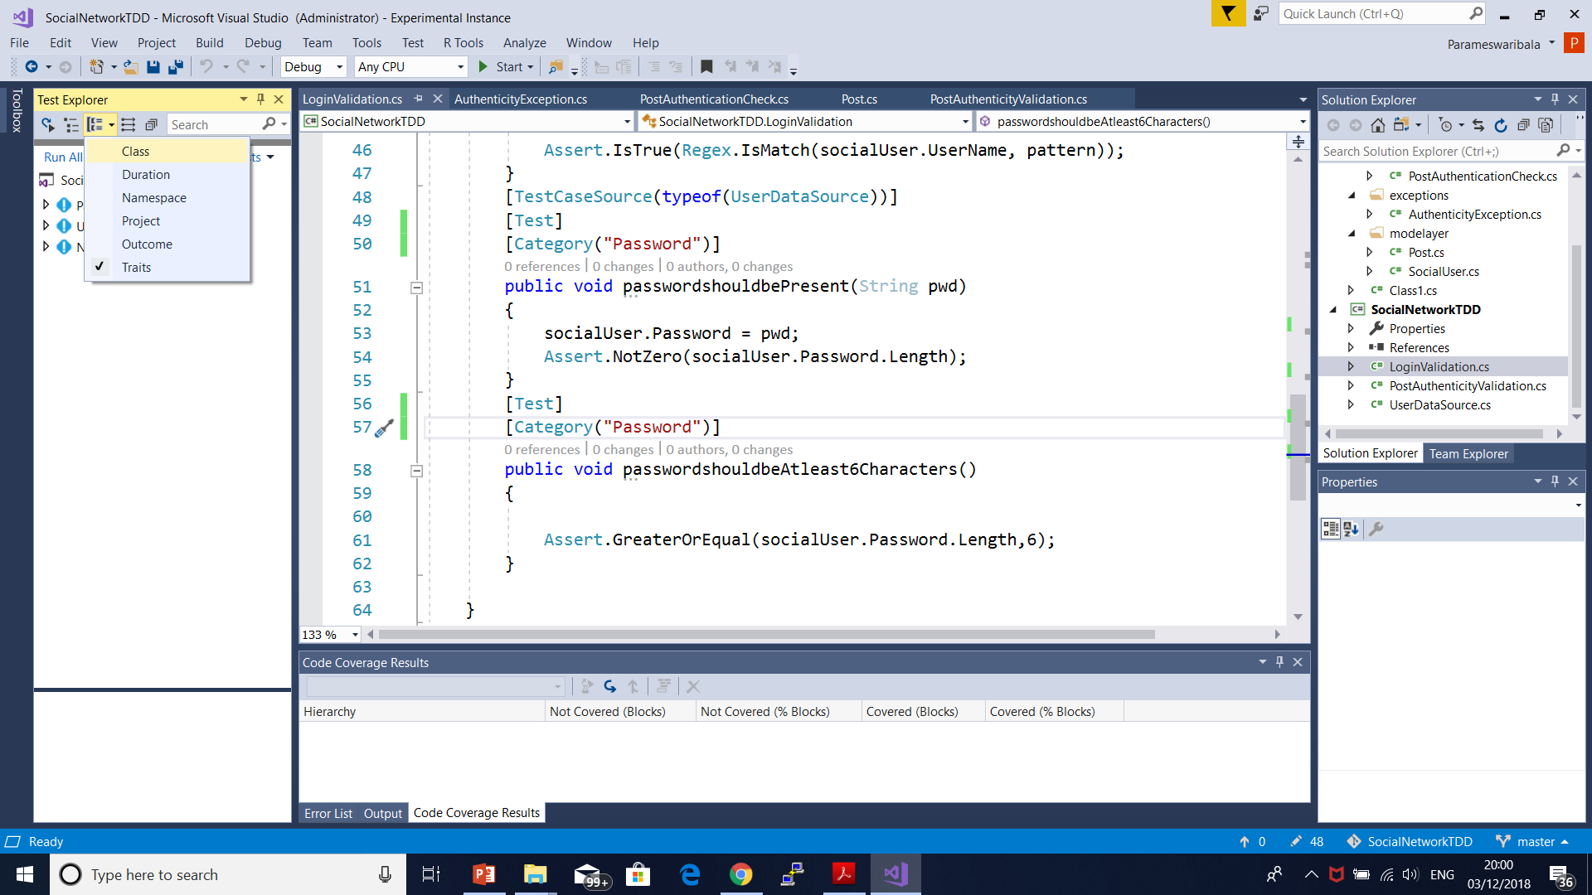
Category Grouping

Slide 108
Combinational Attributes
[Test, Combinatorial]
public void MyTest(
[Values(1, 2, 3)] int x,
[Values("A", "B")] string s)
{
...
}
MyTest is called six times, as follows:
MyTest(1, "A")
MyTest(1, "B")
MyTest(2, "A")
MyTest(2, "B")
MyTest(3, "A")
MyTest(3, "B")

Slide 109
Nunit Attributes
Culture Attribute | Specifies cultures for which a test or fixture should be run. [Culture("fr-FR")]

Slide 110
Nunit Attributes
Description Attribute | Applies descriptive text to a Test, TestFixture or Assembly.
Explicit Attribute | Indicates that a test should be skipped unless explicitly run. [TestFixture, Explicit]
Ignore Attribute | Indicates that a test shouldn't be run for some reason. [Ignore("Ignore a fixture")]
LevelOfParallelism Attribute | Specifies the level of parallelism at assembly level. AssemblyInfo.cs [assembly:LevelOfParallelism(3)]
MaxTime Attribute | Specifies the maximum time in milliseconds for a test case to succeed. [Test, MaxTime(2000)]
NonParallelizable Attribute | Specifies that the test and its descendants may not be run in parallel.
OneTimeSetUp Attribute | Identifies methods to be called once prior to any child tests.
OneTimeTearDown Attribute | Identifies methods to be called once after all child tests.
Order Attribute | Specifies the order in which decorated test should be run (against others). [Test, Order(1)]

Slide 111
Nunit Attributes
Pairwise Attribute | Generate test cases for all possible pairs of the values provided.
Parallelizable Attribute | Indicates whether test and/or its descendants can be run in parallel.
Platform Attribute | Specifies platforms for which a test or fixture should be run. [TestFixture] [Platform("NET-2.0")]
Property Attribute | Allows setting named properties on any test case or fixture.
Random Attribute | Specifies generation of random values as arguments to a parameterized test. public void MyTest( [Values(1, 2, 3)] int x, [Random(-1.0, 1.0, 5)] double d)
Range Attribute | Specifies a range of values as arguments to a parameterized test. public void MyTest( [Values(1, 2, 3)] int x, [Range(0.2, 0.6, 0.2)] double d)
Repeat Attribute | Specifies that the decorated method should be executed multiple times.
RequiresThread Attribute | Indicates that a test method, class or assembly should be run on a separate thread.

Slide 112
Nunit Attributes
Retry Attribute | Causes a test to be rerun if it fails, up to a maximum number of times.
Sequential Attribute | Generates test cases using values in the order provided, without additional combinations.
SetCulture Attribute | Sets the current Culture for the duration of a test.
SetUICulture Attribute | Sets the current UI Culture for the duration of a test.
SetUp Attribute | Indicates a method of a TestFixture called just before each test method.
SetUpFixture Attribute | Marks a class with one-time setup or teardown methods for all the test fixtures in a namespace.
SingleThreaded Attribute | Marks a fixture that requires all its tests to run on the same thread.
TearDown Attribute | Indicates a method of a TestFixture called just after each test method.

Slide 113
Nunit Attributes
Test Attribute | Marks a method of a TestFixture that represents a test.
TestCase Attribute | Marks a method with parameters as a test and provides inline arguments.
TestCaseSource Attribute | Marks a method with parameters as a test and provides a source of arguments.
TestFixture Attribute | Marks a class as a test fixture and may provide inline constructor arguments.
TestFixtureSetup Attribute | Deprecated synonym for OneTimeSetUp Attribute.
TestFixtureSource Attribute | Marks a class as a test fixture and provides a source for constructor arguments.
TestFixtureTeardown Attribute | Deprecated synonym for OneTimeTearDown Attribute.
TestOf Attribute | Indicates the name or Type of the class being tested.
Theory Attribute | Marks a test method as a Theory, a special kind of test in NUnit.
Timeout Attribute | Provides a timeout value in milliseconds for test cases. [Test, Timeout(2000)]
Values Attribute | Provides a set of inline values for a parameter of a test method.
ValueSource Attribute | Provides a source of values for a parameter of a test method.

Slide 114
Nunit Collection Constraints
Constraint Name
AllItemsConstraint
CollectionContainsConstraint
CollectionEquivalentConstraint
CollectionOrderedConstraint
CollectionSubsetConstraint
CollectionSupersetConstraint
EmptyCollectionConstraint
ExactCountConstraint
NoItemConstraint
SomeItemsConstraint
UniqueItemsConstraint

Slide 115
All Items Constraint
int[] iarray = new int[] { 1, 2, 3 };
string[] sarray = new string[] { "a", "b", "c" };
Assert.That(iarray, Is.All.Not.Null);
Assert.That(sarray, Is.All.InstanceOf<string>());
Assert.That(iarray, Is.All.GreaterThan(0));
Assert.That(iarray, Has.All.GreaterThan(0));

Slide 116
Collection Contains Constraint
int[] iarray = new int[] { 1, 2, 3 };
string[] sarray = new string[] { "a", "b", "c" };
Assert.That(iarray, Has.Member(3));
Assert.That(sarray, Has.Member("b"));
Assert.That(sarray, Contains.Item("c"));
Assert.That(sarray, Has.No.Member("x"));
Assert.That(iarray, Does.Contain(3));

Slide 117
Collection Equality Constraint
int[] iarray = new int[] { 1, 2, 3 };
string[] sarray = new string[] { "a", "b", "c" };
Assert.That(new string[] { "c", "a", "b" }, Is.EquivalentTo(sarray));
Assert.That(new int[] { 1, 2, 2 }, Is.Not.EquivalentTo(iarray));

Slide 118
Collection Ordered Constraint
int[] iarray = new int[] { 1, 2, 3 };
Assert.That(iarray, Is.Ordered);
string[] sarray = new string[] { "c", "b", "a" };
Assert.That(sarray, Is.Ordered.Descending);
string[] sarray = new string[] ("a", "aa", "aaa");
Assert.That(sarray, Is.Ordered.By("Length"));
string[] sarray2 = new string[] ("aaa", "aa", "a");
Assert.That(sarray2, Is.Ordered.Descending.By("Length"));

Slide 119
Collection Subset Constraint
int[] iarray = new int[] { 1, 3 };
Assert.That(iarray, Is.SubsetOf(new int[] { 1, 2, 3 }));

Slide 120
Collection Empty Constraint
Assert.That(new int[] { }, Is.Empty);
Assert.That(new int[] { 1, 2, 3 }, Is.Not.Empty);

Slide 121
Collection ExactCount Constraint
int[] array = new int[] { 1, 2, 3 };
Assert.That(array, Has.Exactly(3).Items);
Assert.That(array, Has.Exactly(2).Items.GreaterThan(1));
Assert.That(array, Has.Exactly(3).LessThan(100));
Assert.That(array, Has.Exactly(2).Items.EqualTo(1).Or.EqualTo(3));
Assert.That(array, Has.Exactly(1).EqualTo(1).And.Exactly(1).EqualTo(3));

Slide 122
Collection No Item Constraint
int[] iarray = new int[] { 1, 2, 3 };
string[] sarray = new string[] { "a", "b", "c" };
Assert.That(iarray, Has.None.Null);
Assert.That(sarray, Has.None.EqualTo("d"));
Assert.That(iarray, Has.None.LessThan(0)););

Slide 123
Collection Unique Constraint
Assert.That(collection, Is.Unique);

Slide 124
Collection Sometimes Constraint
int[] iarray = new int[] { 1, 2, 3 };
string[] sarray = new string[] { "a", "b", "c" };
Assert.That(iarray, Has.Some.GreaterThan(2));
Assert.That(sarray, Has.Some.Length(1));

Slide 125
Nunit Comparison Constraints
Constraint Name
GreaterThanConstraint
GreaterThanOrEqualConstraint
LessThanConstraint
LessThanOrEqualConstraint
RangeConstraint

Slide 126
Greater than Constraint
int[] iarray = new int[] { 1, 2, 3 };
string[] sarray = new string[] { "a", "b", "c" };
Assert.That(iarray, Has.Some.GreaterThan(2));
Assert.That(sarray, Has.Some.Length(1));

Slide 127
Greater than or Equal Constraint
Assert.That(7, Is.GreaterThanOrEqualTo(3));
Assert.That(7, Is.AtLeast(3));
Assert.That(7, Is.GreaterThanOrEqualTo(7));
Assert.That(7, Is.AtLeast(7));
Assert.That(myOwnObject,
Is.GreaterThanOrEqualTo(theExpected).Using(myComparer)););

Slide 128
Range Constraint
int[] iarray = new int[] { 1, 2, 3 }
Assert.That(42, Is.InRange(1, 100));
Assert.That(iarray, Is.All.InRange(1, 3));
Assert.That(myOwnObject,
Is.InRange(lowExpected, highExpected).Using(myComparer));

Slide 129
Nunit Compound Constraints
Constraint Name
AndConstraint
NotConstraint
OrConstraint

Slide 130
And ,Not, ORConstraint
Assert.That(2.3, Is.GreaterThan(2.0).And.LessThan(3.0));
Assert.That(collection, Is.Not.Unique);
Assert.That(2 + 2, Is.Not.EqualTo(5));
Assert.That(3, Is.LessThan(5).Or.GreaterThan(10));

Slide 131
Nunit Condition Constraints
Constraint Name
EmptyConstraint
FalseConstraint
NaNConstraint
NullConstraint
TrueConstraint

Slide 132
Nunit File Constraints
Constraint Name
EmptyDirectoryConstraint
FileOrDirectoryExistsConstraint
SamePathConstraint
SamePathOrUnderConstraint
SubPathConstraint

Slide 133
Nunit String Constraints
Constraint Name
EmptyStringConstraint
EndsWithConstraint
RegexConstraint
StartsWithConstraint
SubstringConstraint

Slide 134
Nunit Type Constraints
Constraint Name
AssignableFromConstraint
AssignableToConstraint
ExactTypeConstraint
InstanceOfTypeConstraint

Slide 135
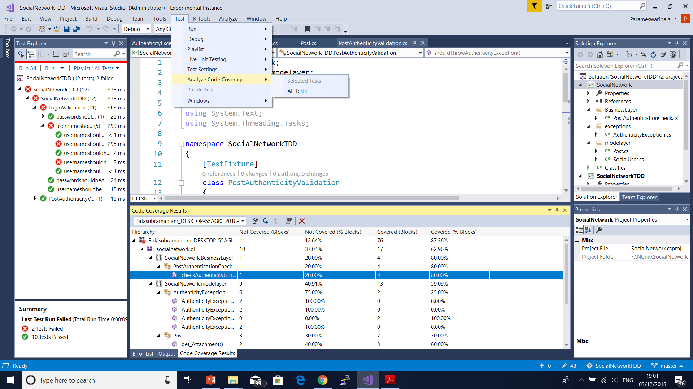
Code Coverage Analysis(Default VS Test)

Slide 136
Mock Objects
Mocking is a process used in unit testing when the unit being tested has external dependencies.
The purpose of mocking is to isolate and focus on the code being tested and not on the behavior or state of external dependencies.
In mocking, the dependencies are replaced by closely controlled replacements objects that simulate the behavior of the real ones.
There are three main possible types of replacement objects - fakes, stubs and mocks.

Slide 137
Fakes
Fakes: A Fake is an object that will replace the actual code by implementing the same interface but without interacting with other objects.
Usually the Fake is hard-coded to return fixed results.
To test for different use cases, a lot of Fakes must be introduced.
The problem introduced by using Fakes is that when an interface has been modified, all fakes implementing this interface should be modified as well.

Slide 138
Stubs
Stubs: A Stub is an object that will return a specific result based on a specific set of inputs and usually won’t respond to anything outside of what is programed for the test.
With JustMock you can create a Stub in a test with a minimal amount of code, making it clear how the dependency will respond and how the tested system should behave.

Slide 139
Mocks
Mocks: A Mock is a much more sophisticated version of a Stub.
It will still return values like a Stub, but it can also be programmed with expectations in terms of how many times each method should be called, in which order and with what data.
With JustMock you can create a Mock with just one line of code, which makes the test more understandable.

Slide 140
Selenium

Slide 141
BDD
Behaviour-Driven Development (BDD) is a collaborative approach to software development that bridges the communication gap between business and IT.
BDD helps teams communicate requirements with more precision, discover defects early and produce software that remains maintainable over time.
It helps teams create business requirements that can be understood by the whole team.
Specifying examples uncovers misunderstanding people might not even be aware of.
Teams that practice BDD focus on preventing defects rather than finding them.
This leads to less rework and quicker time to market.

Slide 142
BDD
Behavior-driven development should be focused on the business behaviors your code is implementing: the “why” behind the code.
It supports a team-centric (especially cross-functional) workflow.
I’ve seen agile BDD work really well when a developer and either the Agile product owner or a business analyst sit down together and write pending specs (to be filled in later by the developer) in a plain text editor:
The business person specifies behaviors they want to see in the system.
The developer asks questions based on their understanding of the system, while also writing down additional behaviors needed from a development perspective.
Ideally, both parties can refer to the list of current system behaviors to see if this new feature will break existing features.

Slide 143

BDD

Slide 144
BDD Scenario
The scenario: You’re a developer on a team responsible for the company accounting system, implemented in Rails.
One day, a business person asks you to implement a reminder system to remind clients of their pending invoices.
Because you’re practicing BDD,you sit down with that business person and start defining behaviors.
You open your text editor and start creating pending specs for the behaviors the business user wants:
it "adds a reminder date when an invoice is created"
it "sends an email to the invoice's account's primary contact after the reminder date has passed"
it "marks that the user has read the email in the invoice"

Slide 145
TDD vs BDD
TDD describes how the software works.
On the other hand, BDD −
Describes how the end user uses the software.
Focuses on collaboration and communication.
Emphasizes on examples of behavior of the System.
Aims at the executable specifications derived from the examples

Slide 146
TDD vs BDD
BDD is in a more readable format by every stake holder since it is in English, unlike TDD test cases written in programming languages such as Ruby, Java etc.
BDD explains the behavior of an application for the end user while TDD focuses on how functionality is implemented. Changes on functionality can be accommodated with less impact in BDD as opposed to TDD.
BDD enables all the stakeholders to be on the same page with requirements which makes acceptance easy, as opposed to TDD.

Slide 147
BDD Tools Cucumber & SpecFlow
Cucumber is a testing framework which supports Behavior Driven Development (BDD).
It lets us define application behavior in plain meaningful English text using a simple grammar defined by a language called Gherkin.
Cucumber itself is written in Ruby, but it can be used to “test” code written in Ruby or other languages including but not limited to Java, C# and Python.

Slide 148
BDD Tools Cucumber & SpecFlow
SpecFlow is inspired by Cucumber framework in the Ruby on Rails world.
Cucumber uses plain English in the Gherkin format to express user stories.
Once the user stories and their expectations are written, the Cucumber gem is used to execute those stores.
SpecFlow brings the same concept to the .NET world and allows the developer to express the feature in plain English language.
It also allows to write specification in human readable Gherkin format..

Slide 149
Gherkin
Gherkin is a Business Readable, Domain Specific Language created especially for behavior descriptions.
It gives you the ability to remove logic details from behavior tests.
Gherkin serves two purposes: serving as your project’s documentation and automated tests.

Slide 150
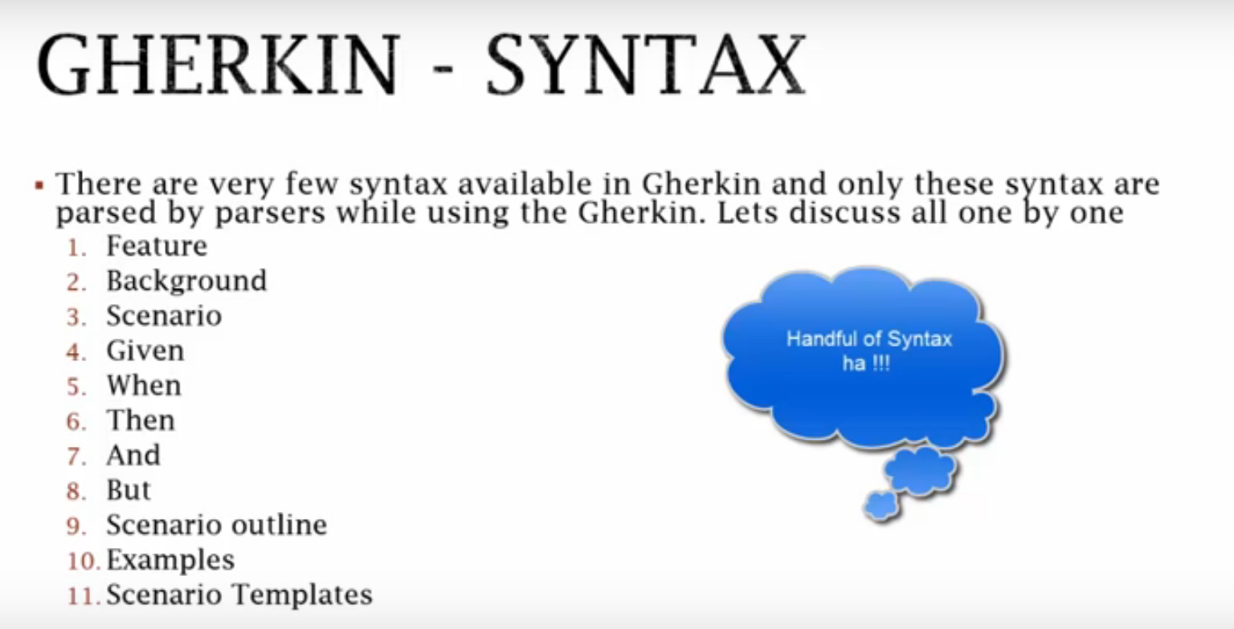
Gherkin Syntax

Slide 151
Gherkin DSL
Feature: Serve coffee
In order to earn money
Customers should be able to buy coffee at all times
Scenario: Buy last coffee
Given there are 1 coffee left in the machine
And I have deposited 1 dollar
When I press the coffee button
Then I should be served a coffee

Slide 152
Gherkin User Login
Feature − Login functionality for a social networking site.
Given I am a social networking site user.
When I enter username as username1.
And I enter password as password1.
Then I should be redirected to the home page of the site.

Slide 153
Gherkin User Signup
Feature: Sign up
Sign up should be quick and friendly.
Scenario: Successful sign up New users should get a confirmation email and be greeted personally by the site once signed in.
Given I have chosen to sign up When I sign up with valid details Then I should receive a confirmation email And I should see a personalized greeting message
Scenario: Duplicate email
Where someone tries to create an account for an email address that already exists.
Given I have chosen to sign up But I enter an email address that has already registered Then I should be told that the email is already registered And I should be offered the option to recover my password

Slide 154
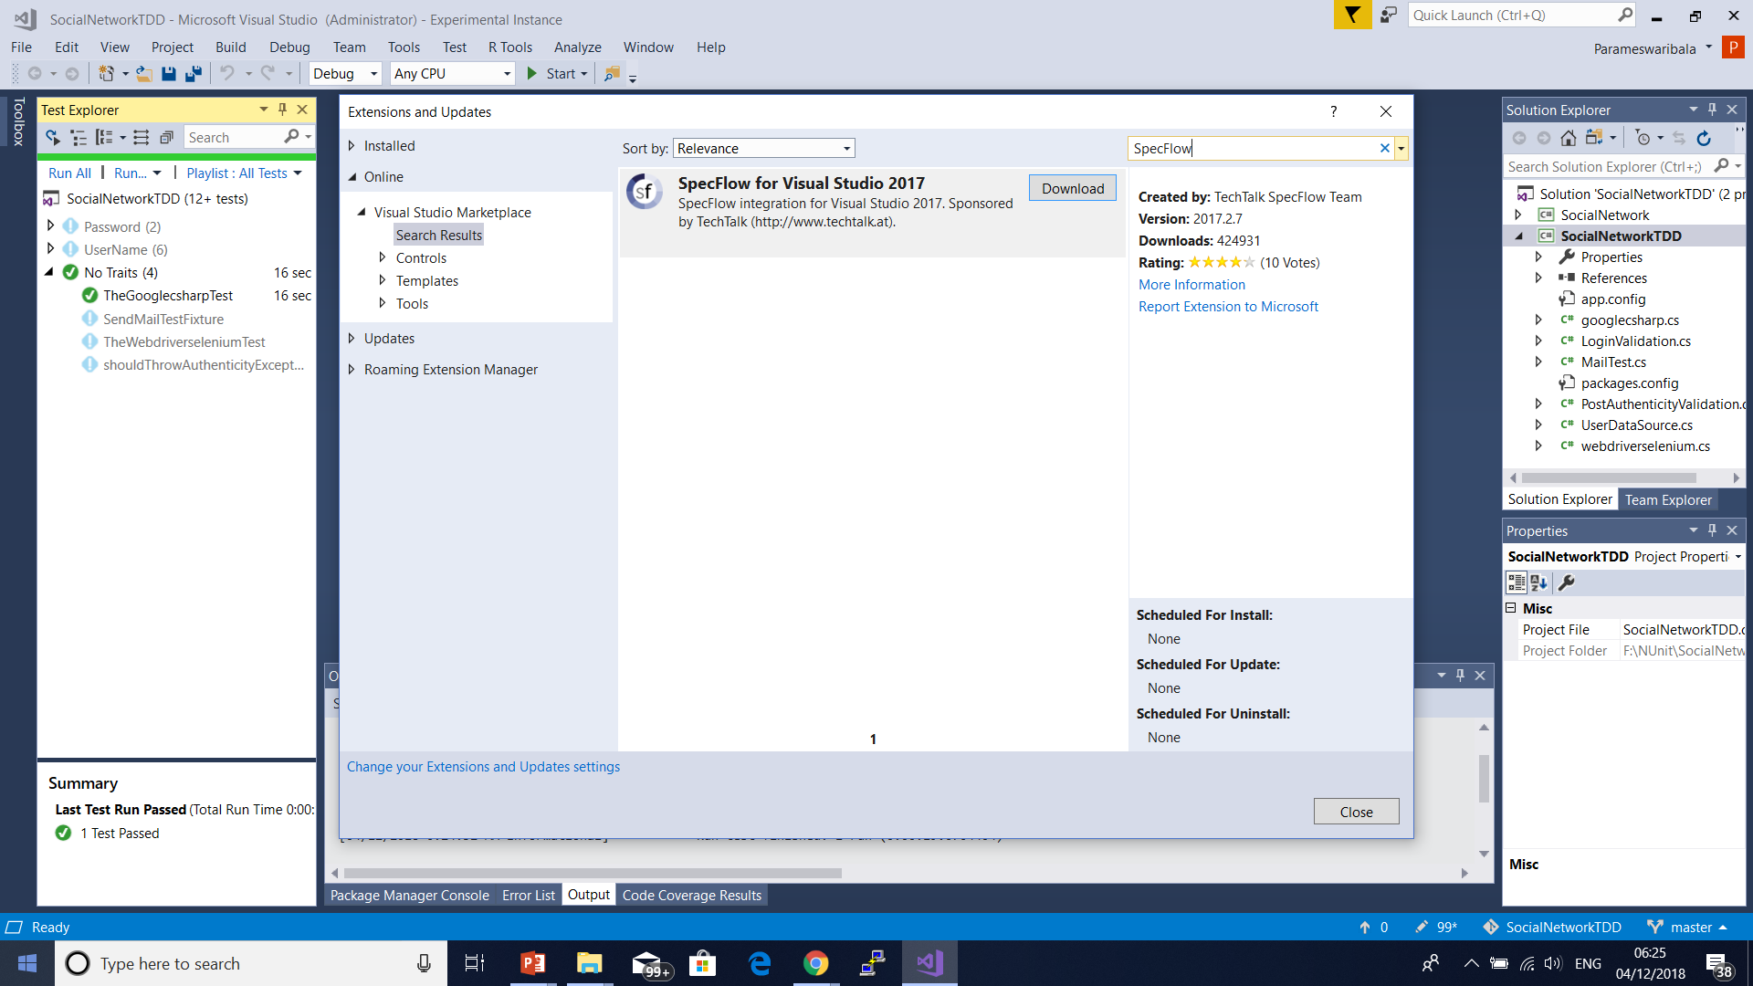

Slide 155
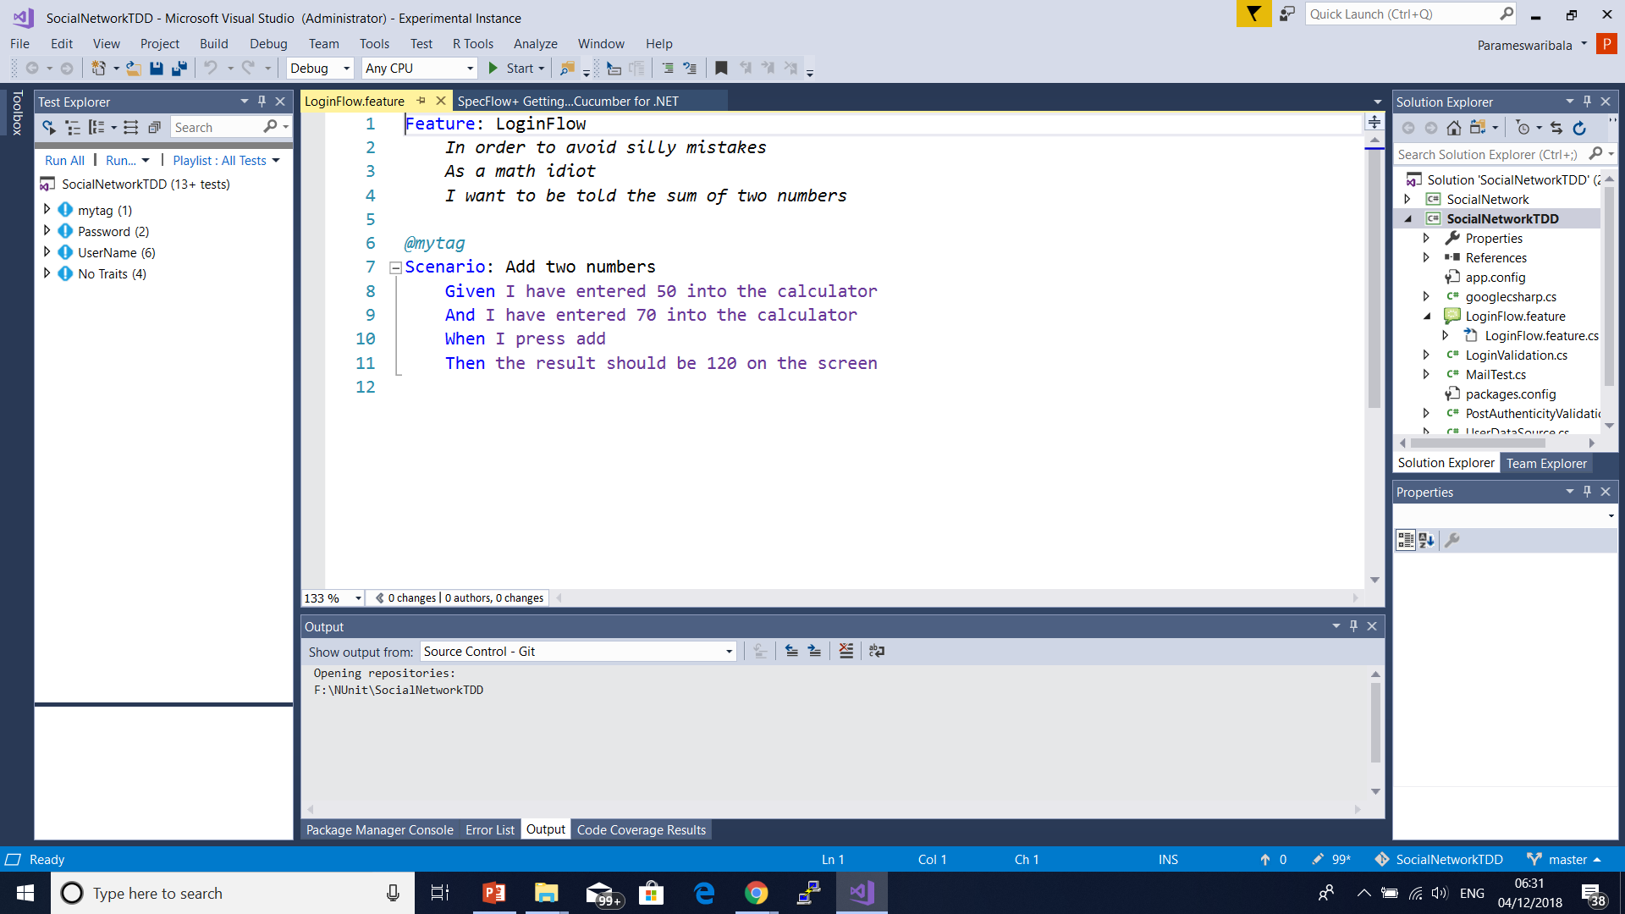
Add SpecFlow Feature from Add New Item in Class Library Project

Slide 156
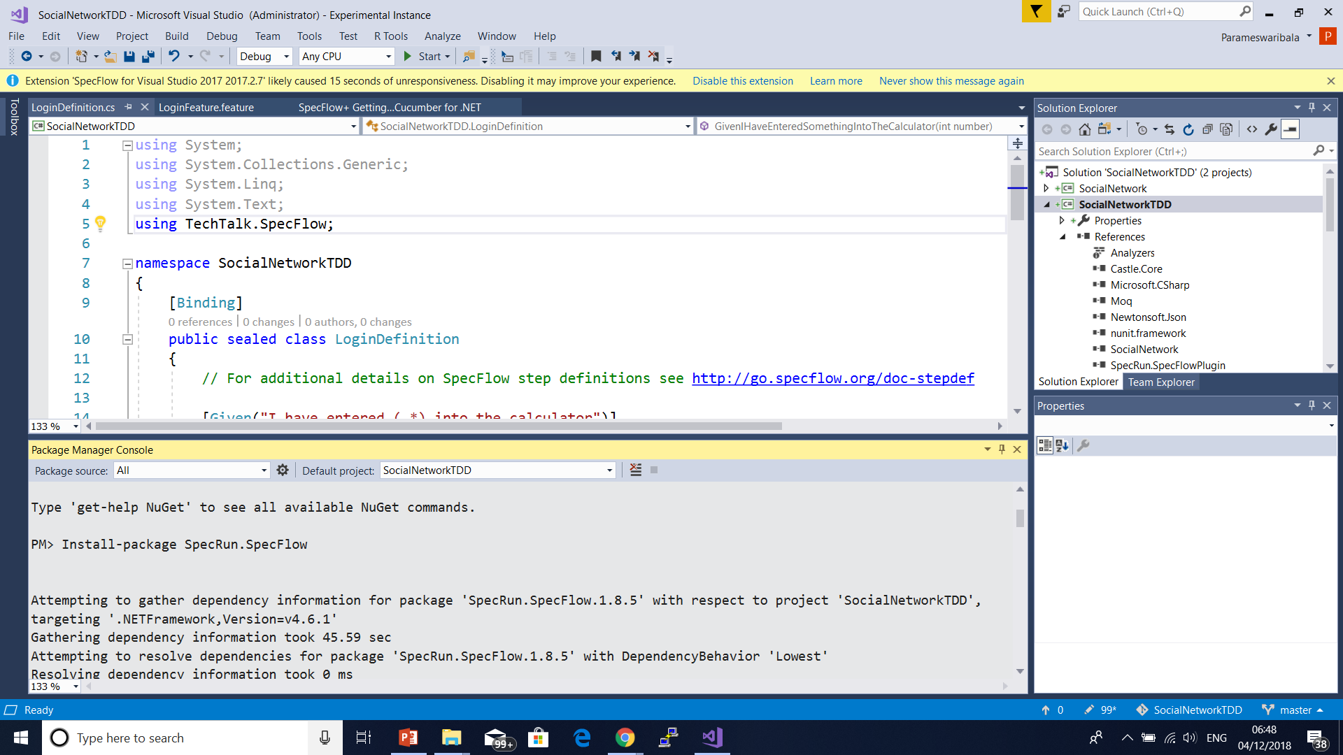

Slide 157
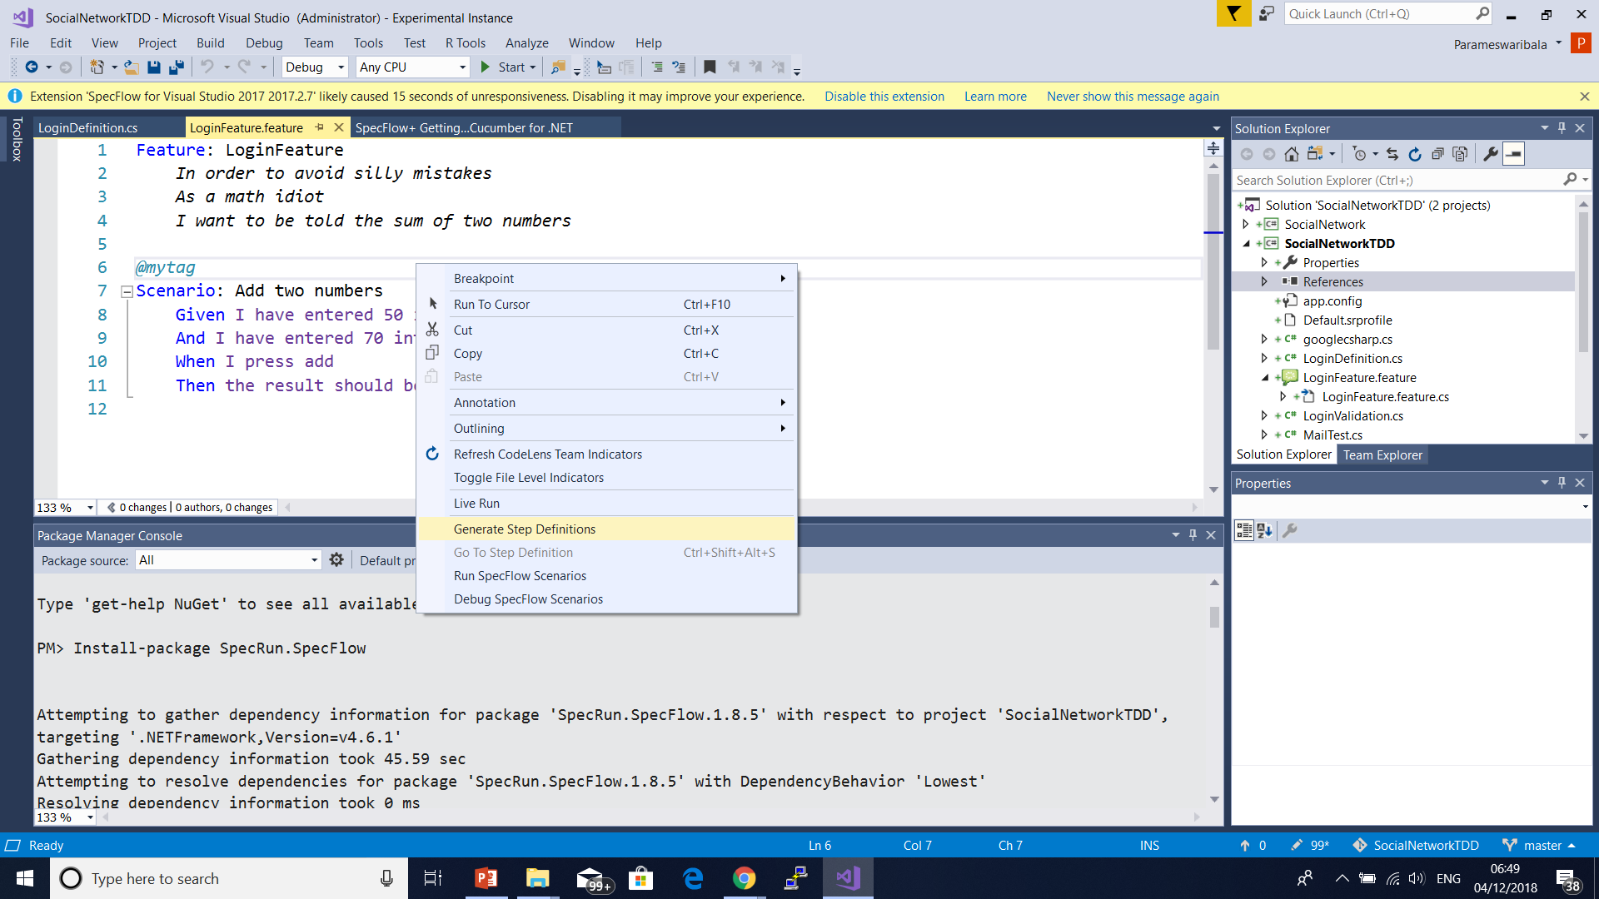

Slide 158
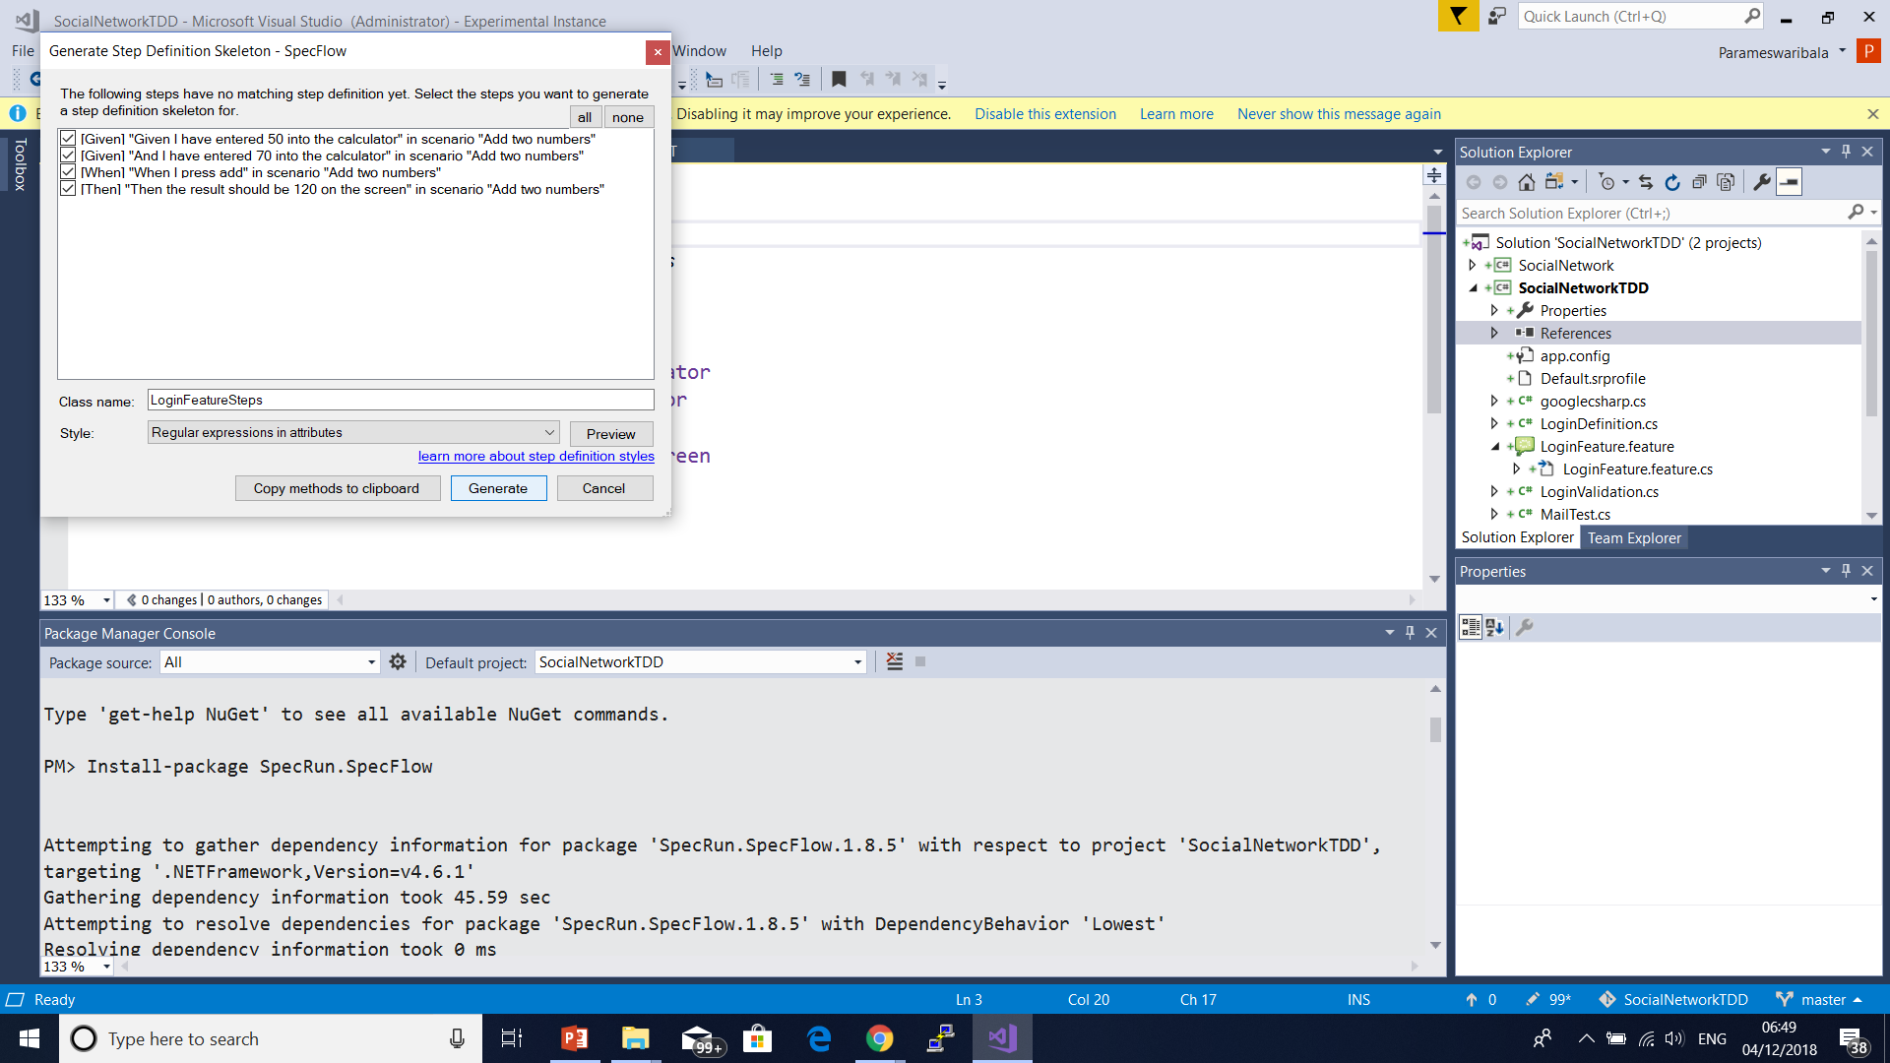

Slide 159
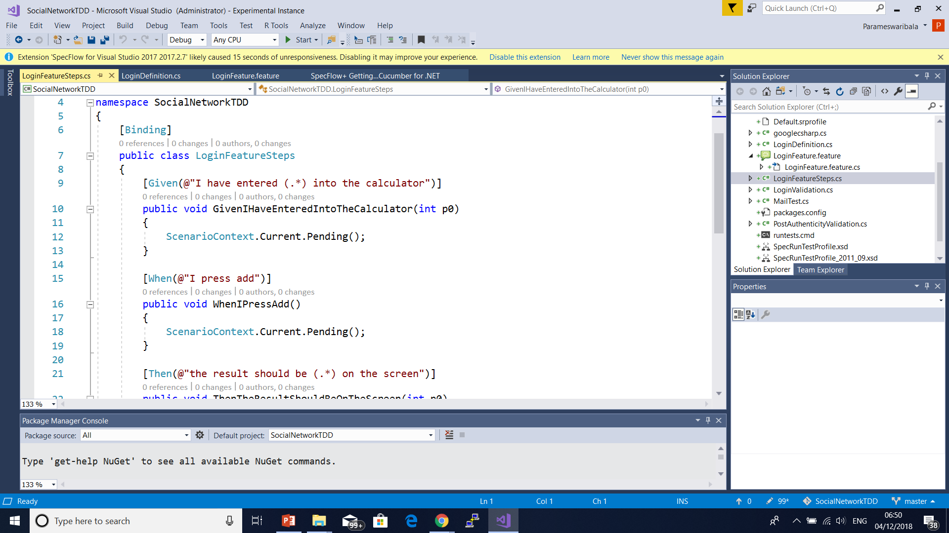

Slide 160
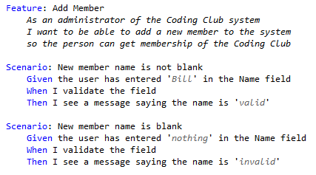

Slide 161
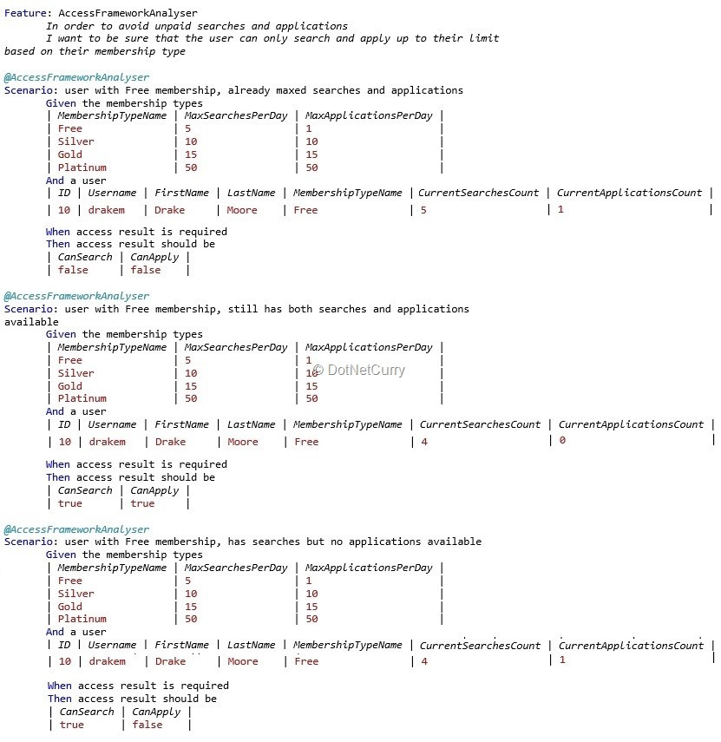

Slide 162
Questions

Slide 163
Module Summary

